Slide 1
A Day in the Ministry of Jesus
2024 Quarter 3 Lesson 02
Mark 1:16-45

Slide 2
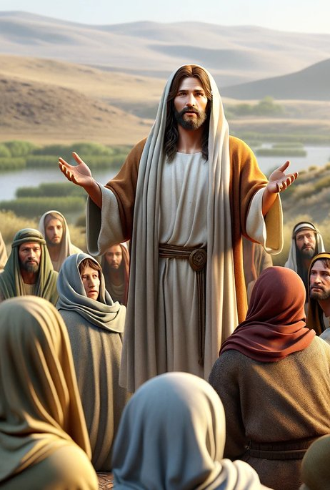
Memory Text: Mark 1:17
17 And Jesus said unto them, Come ye after me, and I will make you to become fishers of men.

Slide 3
Matthew 1:1-2
Luke 1:5
1 The book of the generation of Jesus Christ, the son of David, the son of Abraham.
2 Abraham begat Isaac; and Isaac begat Jacob; and Jacob begat Judas and his brethren;
5 There was in the days of Herod, the king of Judaea, a certain priest named Zacharias, of the course of Abia: and his wife was of the daughters of Aaron, and her name was Elisabeth…

Slide 4
John 1:1-3
Mark 1:1-2
1 In the beginning was the Word, and the Word was with God, and the Word was God.
2 The same was in the beginning with God.
3 All things were made by him; and without him was not any thing made that was made.
1 The beginning of the gospel of Jesus Christ, the Son of God;
2 As it is written in the prophets, Behold, I send my messenger before thy face, which shall prepare thy way before thee.

Slide 5
The Greatest Story Begins
Unlike Matthew and Luke, who narrate incidents from the early life of Jesus, Mark begins his gospel record with the moment at which Jesus began His public ministry. The descent of the Holy Spirit and John’s announcement of Jesus as the Messiah, unmistakably mark His baptism as the commencement of His public ministry. According to Mark, then, the gospel, the “good news” about Jesus Christ, begins with the fulfillment of Old Testament prophecy at His baptism.

Slide 6
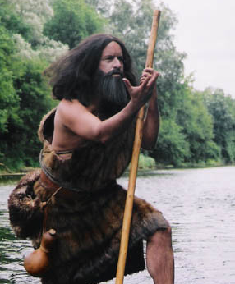
The Beginning
Mark 1:3-15
3 The voice of one crying in the wilderness, Prepare ye the way of the Lord, make his paths straight.
4 John did baptize in the wilderness, and preach the baptism of repentance for the remission of sins.

Slide 7
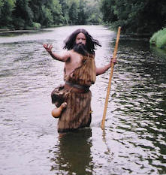
The Beginning
Mark 1:5-15
5 And there went out unto him all the land of Judaea, and they of Jerusalem, and were all baptized of him in the river of Jordan, confessing their sins.
6 And John was clothed with camel's hair, and with a girdle of a skin about his loins; and he did eat locusts and wild honey;

Slide 8
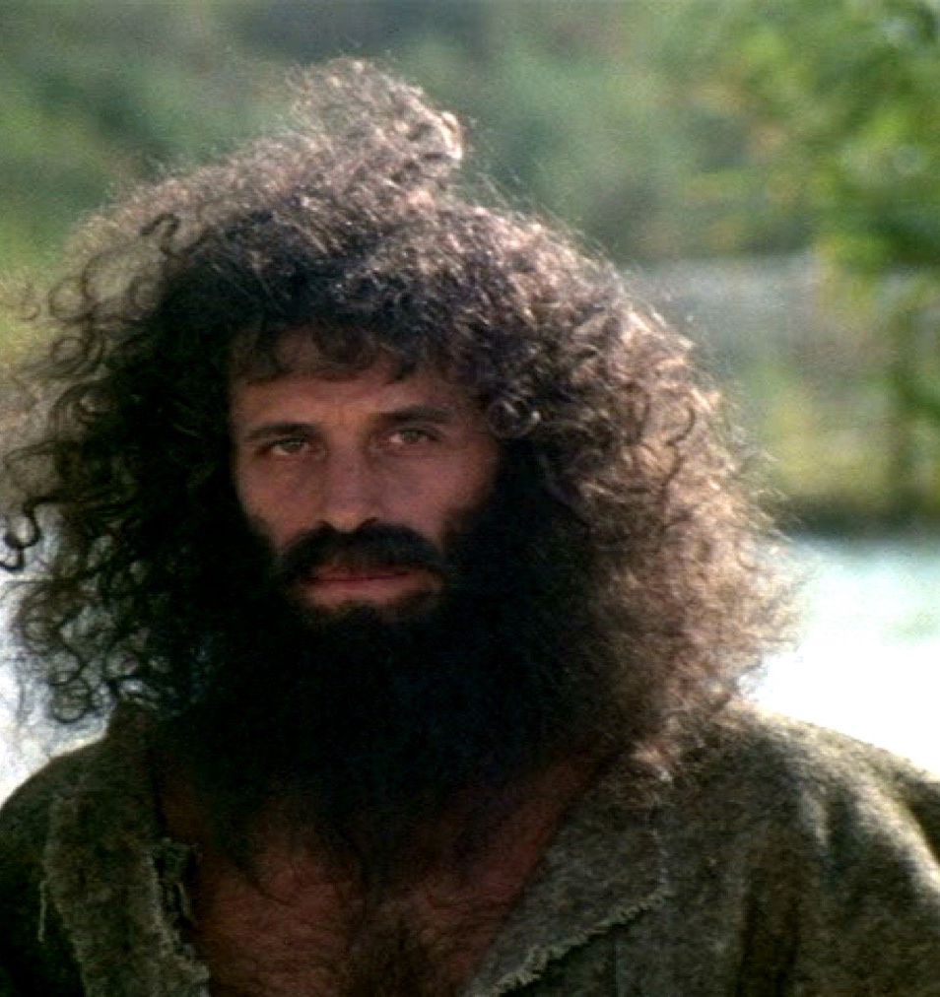
The Beginning
Mark 1:7-15
7 And preached, saying, There cometh one mightier than I after me, the latchet of whose shoes I am not worthy to stoop down and unloose.
8 I indeed have baptized you with water: but he shall baptize you with the Holy Ghost.

Slide 9
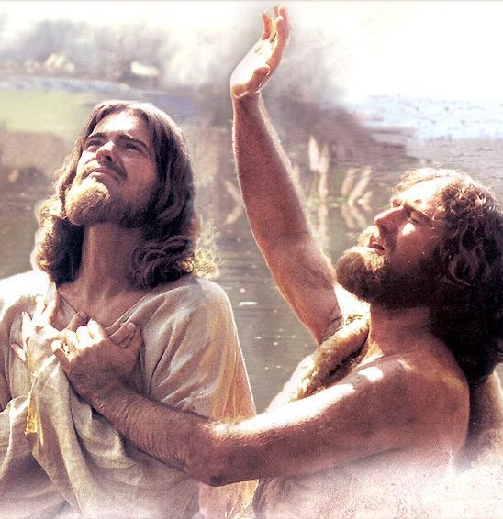
The Beginning
Mark 1:9-15
9 And it came to pass in those days, that Jesus came from Nazareth of Galilee, and was baptized of John in Jordan.
10 And straightway coming up out of the water, he saw the heavens opened, and the Spirit like a dove descending upon him:

Slide 10
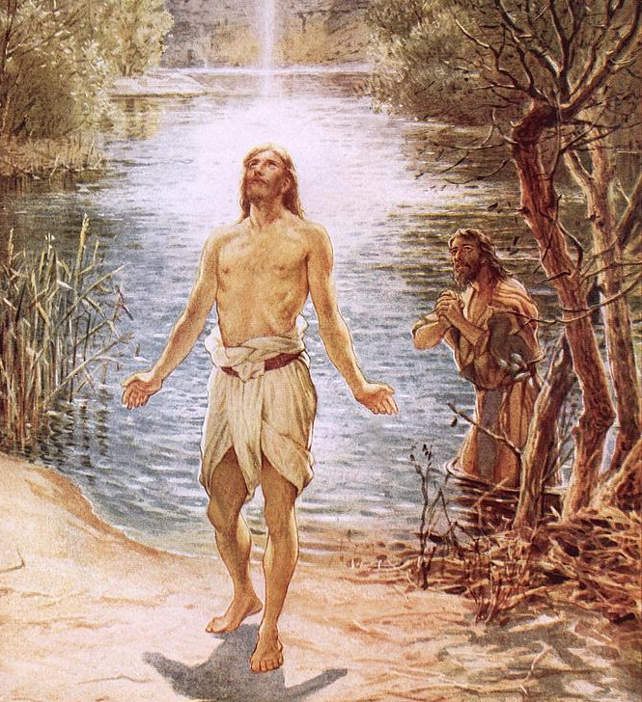
The Beginning
Mark 1:11-15
11 And there came a voice from heaven, saying, Thou art my beloved Son, in whom I am well pleased.
12 And immediately the spirit driveth him into the wilderness.

Slide 11
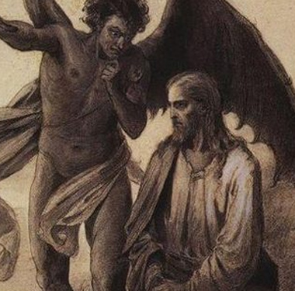
The Beginning
Mark 1:12-15
12 And immediately the spirit driveth him into the wilderness.
13 And he was there in the wilderness forty days, tempted of Satan; and was with the wild beasts; and the angels ministered unto him.

Slide 12
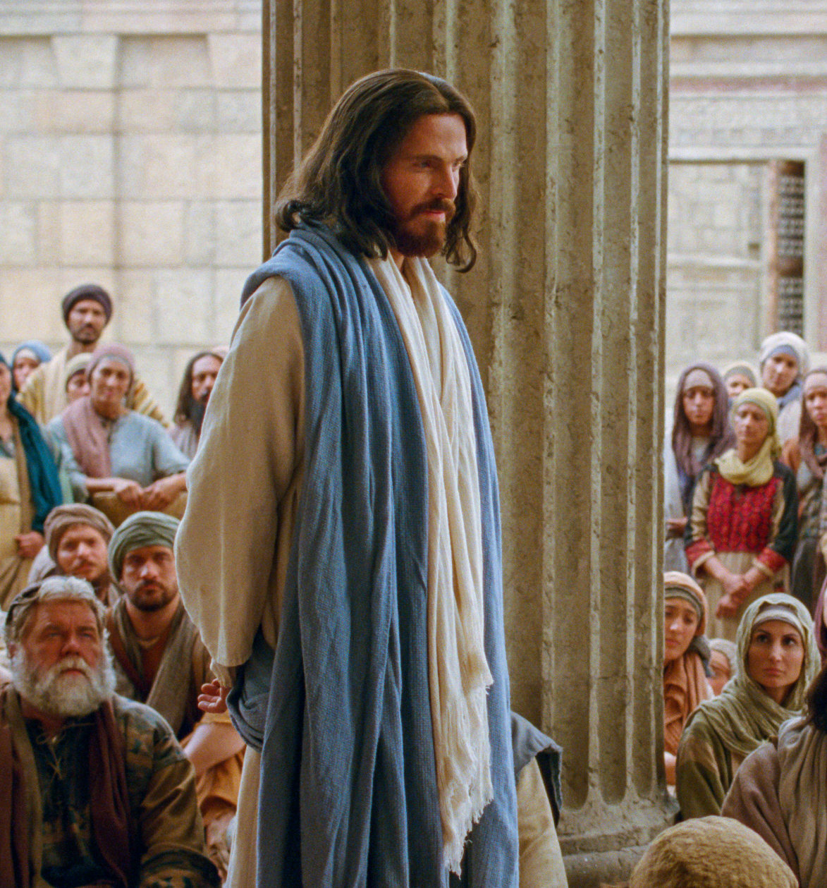
The Beginning
Mark 1:14-15
14 Now after that John was put in prison, Jesus came into Galilee, preaching the gospel of the kingdom of God,
15 And saying, The time is fulfilled, and the kingdom of God is at hand: repent ye, and believe the gospel.

Slide 13
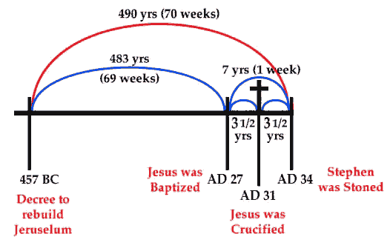
Daniel 9:24-27
24 Seventy weeks are determined upon thy people….

Slide 14
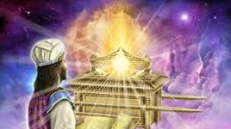
Time Fulfilled
24 Seventy weeks are determined upon thy people and upon thy holy city, to finish the transgression, and to make an end of sins, and to make reconciliation for iniquity, and to bring in everlasting righteousness, and to seal up the vision and prophecy, and to anoint the most Holy.

Slide 15
Time Fulfilled
25 Know therefore and understand, that from the going forth of the commandment to restore and to build Jerusalem unto the Messiah the Prince shall be seven weeks, and threescore and two weeks: the street shall be built again, and the wall, even in troublous times.

Slide 16
Time Fulfilled
26 And after threescore and two weeks shall Messiah be cut off, but not for himself: and the people of the prince that shall come shall destroy the city and the sanctuary; and the end thereof shall be with a flood, and unto the end of the war desolations are determined.

Slide 17
Time Fulfilled
27 And he shall confirm the covenant with many for one week: and in the midst of the week he shall cause the sacrifice and the oblation to cease, and for the overspreading of abominations he shall make it desolate, even until the consummation, and that determined shall be poured upon the desolate.

Slide 18
Time Fulfilled
24 Seventy weeks are determined upon thy people and upon thy holy city, to finish the transgression, and to make an end of sins, and to make reconciliation for iniquity, and to bring in everlasting righteousness, and to seal up the vision and prophecy, and to anoint the most Holy.
25 Know therefore and understand, that from the going forth of the commandment to restore and to build Jerusalem unto the Messiah the Prince shall be seven weeks, and threescore and two weeks: the street shall be built again, and the wall, even in troublous times.

Slide 19
Peter & Andrew
LUKE 5:1-11
5 And it came to pass, that, as the people pressed upon him to hear the word of God, he stood by the lake of Gennesaret,
2 And saw two ships standing by the lake: but the fishermen were gone out of them, and were washing their nets.
16 Now as he walked by the sea of Galilee, he saw Simon and Andrew his brother casting a net into the sea: for they were fishers.
17 And Jesus said unto them, Come ye after me, and I will make you to become fishers of men.
18 And straightway they forsook their nets, and followed him.

Slide 20
Peter & Andrew
LUKE 5:3-11
3 And he entered into one of the ships, which was Simon's, and prayed him that he would thrust out a little from the land. And he sat down, and taught the people out of the ship.
16 Now as he walked by the sea of Galilee, he saw Simon and Andrew his brother casting a net into the sea: for they were fishers.
17 And Jesus said unto them, Come ye after me, and I will make you to become fishers of men.
18 And straightway they forsook their nets, and followed him.

Slide 21
Peter & Andrew
LUKE 5:4-11
4 Now when he had left speaking, he said unto Simon, Launch out into the deep, and let down your nets for a draught.
5 And Simon answering said unto him, Master, we have toiled all the night, and have taken nothing: nevertheless at thy word I will let down the net.
16 Now as he walked by the sea of Galilee, he saw Simon and Andrew his brother casting a net into the sea: for they were fishers.
17 And Jesus said unto them, Come ye after me, and I will make you to become fishers of men.
18 And straightway they forsook their nets, and followed him.

Slide 22
Peter & Andrew
LUKE 5:6-11
6 And when they had this done, they inclosed a great multitude of fishes: and their net brake.
7 And they beckoned unto their partners, which were in the other ship, that they should come and help them. And they came, and filled both the ships, so that they began to sink.
16 Now as he walked by the sea of Galilee, he saw Simon and Andrew his brother casting a net into the sea: for they were fishers.
17 And Jesus said unto them, Come ye after me, and I will make you to become fishers of men.
18 And straightway they forsook their nets, and followed him.

Slide 23
Peter & Andrew
LUKE 5:8-11
8 When Simon Peter saw it, he fell down at Jesus' knees, saying, Depart from me; for I am a sinful man, O Lord.
9 For he was astonished, and all that were with him, at the draught of the fishes which they had taken:
16 Now as he walked by the sea of Galilee, he saw Simon and Andrew his brother casting a net into the sea: for they were fishers.
17 And Jesus said unto them, Come ye after me, and I will make you to become fishers of men.
18 And straightway they forsook their nets, and followed him.

Slide 24
Peter & Andrew
LUKE 5:10-11
10 And so was also James, and John, the sons of Zebedee, which were partners with Simon. And Jesus said unto Simon, Fear not; from henceforth thou shalt catch men.
11 And when they had brought their ships to land, they forsook all, and followed him.
16 Now as he walked by the sea of Galilee, he saw Simon and Andrew his brother casting a net into the sea: for they were fishers.
17 And Jesus said unto them, Come ye after me, and I will make you to become fishers of men.
18 And straightway they forsook their nets, and followed him.

Slide 25
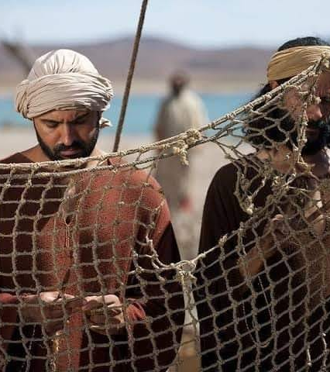
James & John
19 And when he had gone a little farther thence, he saw James the son of Zebedee, and John his brother, who also were in the ship mending their nets.
20 And straightway he called them: and they left their father Zebedee in the ship with the hired servants, and went after him.

Slide 26
The Desire of Ages, p. 273
At the moment of success, when the nets were filled with fish, and the impulses of the old life were strongest, Jesus asked the disciples at the sea to leave all for the work of the gospel. So every soul is tested as to whether the desire for temporal good or for fellowship with Christ is strongest.
Principle is always exacting.

Slide 27

Fishers of Men
The Master Fisherman, this very moment, was “catching” Peter, Andrew, James, and John. The miracle was His “net.” His purpose in “catching” these four men “alive” was that they, in turn, should “catch” others “alive.” This phrasing wasn’t entirely new!
SDA COMMENTARY on LUKE 5:10

Slide 28
15 But, The Lord liveth, that brought up the children of Israel from the land of the north, and from all the lands whither he had driven them: and I will bring them again into their land that I gave unto their fathers.
16 Behold, I will send for many fishers, saith the Lord, and they shall fish them; and after will I send for many hunters, and they shall hunt them from every mountain, and from every hill, and out of the holes of the rocks.
Jeremiah 16:15-16

Slide 29
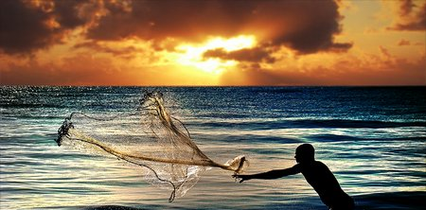
Fishers of Men
What a contrast! All their lives they had caught fish, which died as a result of capture; henceforth they were to catch men, “that they might have life, and that they might have it more abundantly.”
SDA COMMENTARY on LUKE 5:10

Slide 30
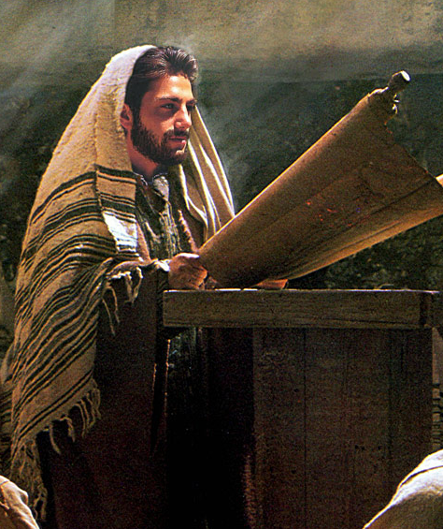
The Demoniac
Mark 1:21-28
21 And they went into Capernaum; and straightway on the sabbath day he entered into the synagogue, and taught.
22 And they were astonished at his doctrine: for he taught them as one that had authority, and not as the scribes.

Slide 31
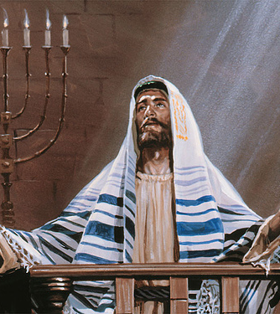
Teaching with Authority
This characteristic set the teaching of Christ in strong contrast with that of the scribes, and was commented on again and again by those who heard Him

Slide 32
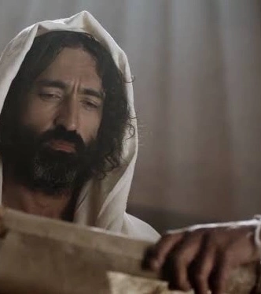
Teaching with Authority
Instead of dwelling upon what men of past ages had thought and written, and appealing to this as authority, He spoke forth as having authority in Himself directly from the Father.

Slide 33
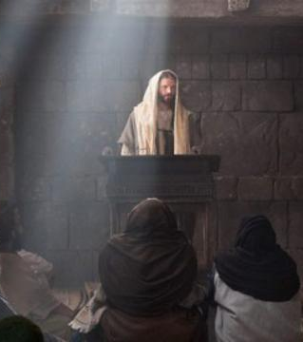
Teaching with Authority
The scribes were wont to say that a certain rabbi had said thus and so, whereas Jesus declared, “I say unto you.” It is true today as it was then that only the preaching of spiritual certainties can bring healing to the sin-sick souls of men.

Slide 34
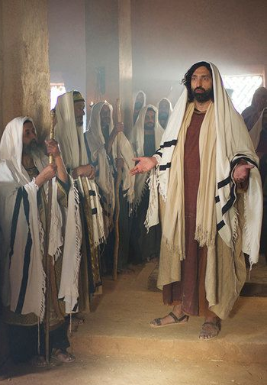
The Demoniac
Mark 1:23-28
23 And there was in their synagogue a man with an unclean spirit; and he cried out,
24 Saying, Let us alone; what have we to do with thee, thou Jesus of Nazareth? art thou come to destroy us? I know thee who thou art, the Holy One of God.

Slide 35

The Demoniac
Mark 1:25-28
25 And Jesus rebuked him, saying, Hold thy peace, and come out of him.
26 And when the unclean spirit had torn him, and cried with a loud voice, he came out of him.

Slide 36
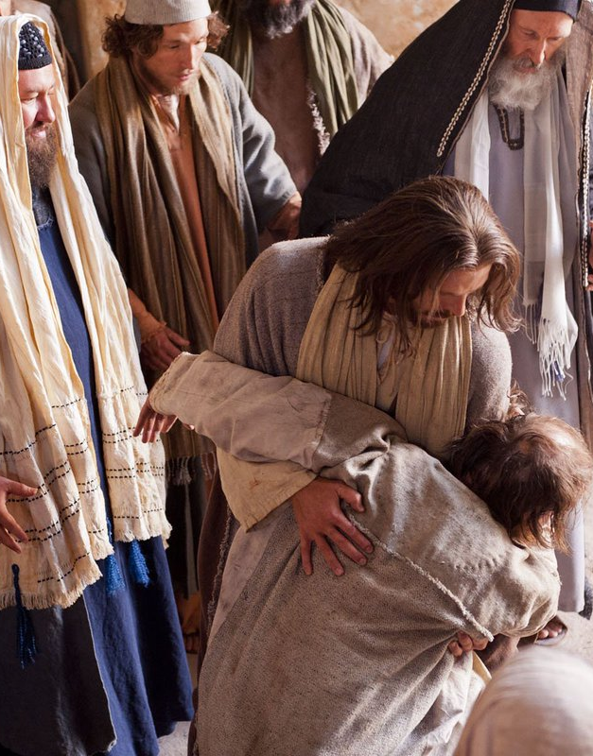
The Demoniac
Mark 1:25-28
27 And they were all amazed, insomuch that they questioned among themselves, saying, What thing is this? what new doctrine is this? for with authority commandeth he even the unclean spirits, and they do obey him.
28 And immediately his fame spread abroad throughout all the region round about Galilee.

Slide 37
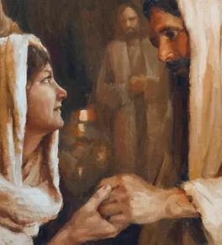
Galilean Ministry
Mark 1:29-45
29 And forthwith, when they were come out of the synagogue, they entered into the house of Simon and Andrew, with James and John.
30 But Simon's wife's mother lay sick of a fever, and anon they tell him of her.

Slide 38
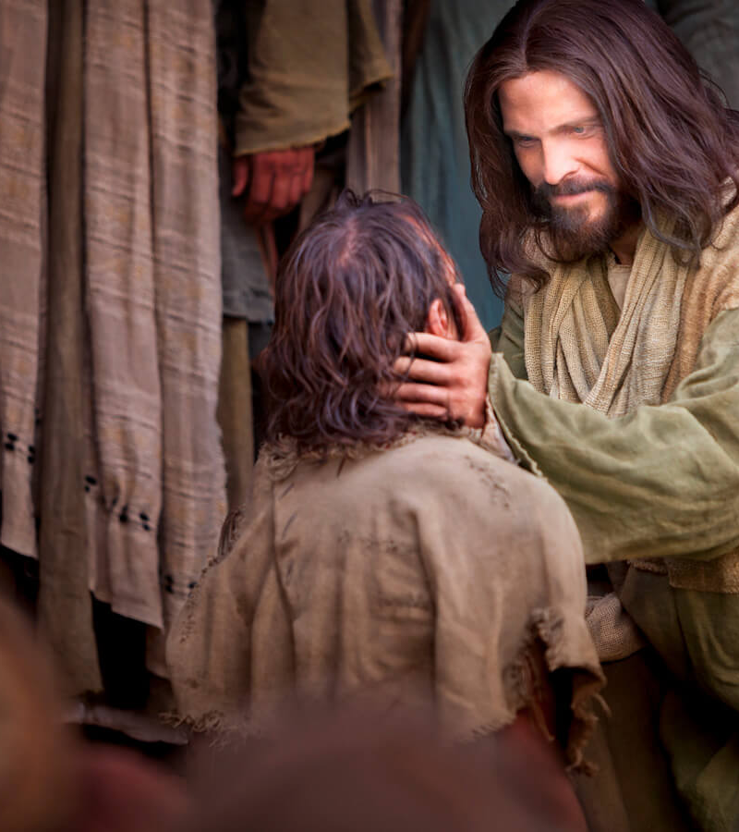
Galilean Ministry
Mark 1:32-45
32 And at even, when the sun did set, they brought unto him all that were diseased, and them that were possessed with devils.
33 And all the city was gathered together at the door.

Slide 39
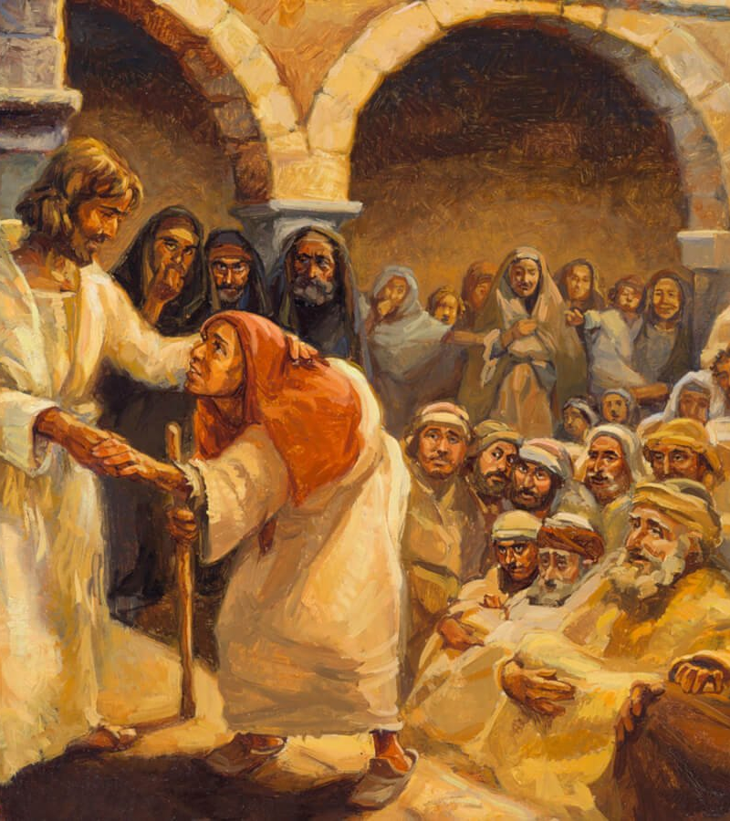
Galilean Ministry
Mark 1:34-45
34 And he healed many that were sick of divers diseases, and cast out many devils; and suffered not the devils to speak, because they knew him.
35 And in the morning, rising up a great while before day, he went out, and departed into a solitary place, and there prayed.

Slide 40
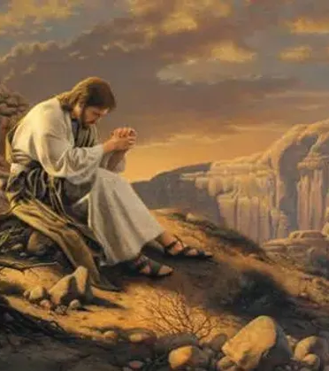
Galilean Ministry
Mark 1:36-45
36 And Simon and they that were with him followed after him.
37 And when they had found him, they said unto him, All men seek for thee.
38 And he said unto them, Let us go into the next towns, that I may preach there also: for therefore came I forth.

Slide 41
The Perils of Fame (SDA Commentary)
Jesus proposed to retreat before the sudden wave of popularity that was about to submerge the true objectives of His ministry. More harm than good would result from acceding to the unenlightened clamor of the people, and He refused to be ensnared.

Slide 42
The Perils of Fame (SDA Commentary)
Jesus considered His miracles a means to the end of the leading men to an awareness of their need for the healing of the soul, but the multitudes saw no further than the miracles themselves. Short of sight, they mistook the means for the end, but the means without the end would tend only to carry them further than ever from the kingdom Christ had come to proclaim. Unless these false conceptions of His work could be dispelled, all Christ’s endeavors would be in vain.

Slide 43
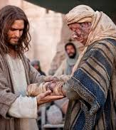
Galilean Ministry
Mark 1:39-45
39 And he preached in their synagogues throughout all Galilee, and cast out devils.
40 And there came a leper to him, beseeching him, and kneeling down to him, and saying unto him, If thou wilt, thou canst make me clean.

Slide 44
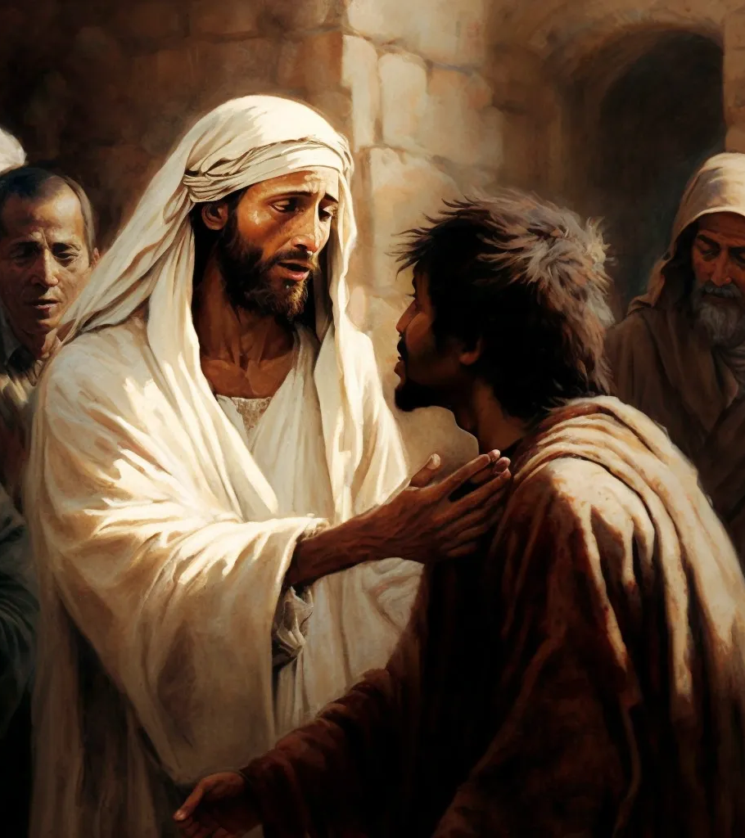
Galilean Ministry
Mark 1:41-45
41 And Jesus, moved with compassion, put forth his hand, and touched him, and saith unto him, I will; be thou clean.
42 And as soon as he had spoken, immediately the leprosy departed from him, and he was cleansed.

Slide 45
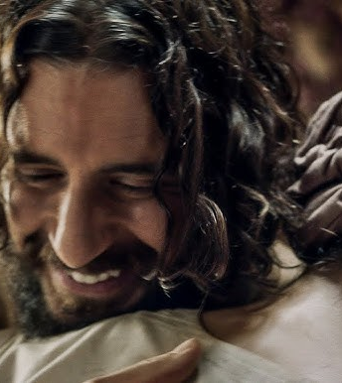
Galilean Ministry
Mark 1:43-45
43 And he straitly charged him, and forthwith sent him away;
44 And saith unto him, See thou say nothing to any man: but go thy way, shew thyself to the priest, and offer for thy cleansing those things which Moses commanded, for a testimony unto them.

Slide 46
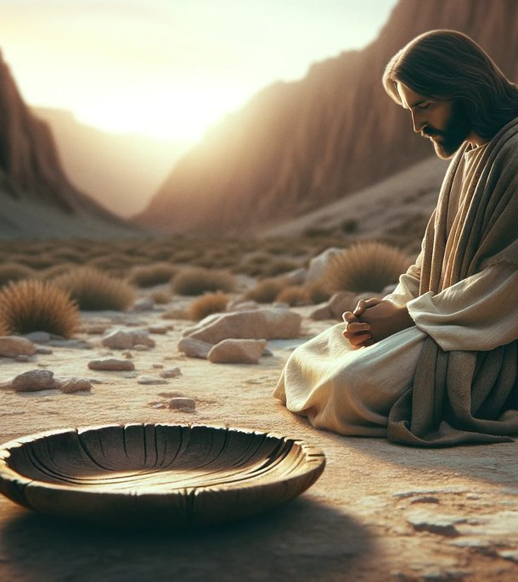
Galilean Ministry
Mark 1:45
45 But he went out, and began to publish it much, and to blaze abroad the matter, insomuch that Jesus could no more openly enter into the city, but was without in desert places: and they came to him from every quarter.;

Slide 47
Thank you!
Happy Sabbath!!

